Slide 1
British Airways Passengers Bookings
Task 2: Predictive modeling of customer bookings

Slide 2
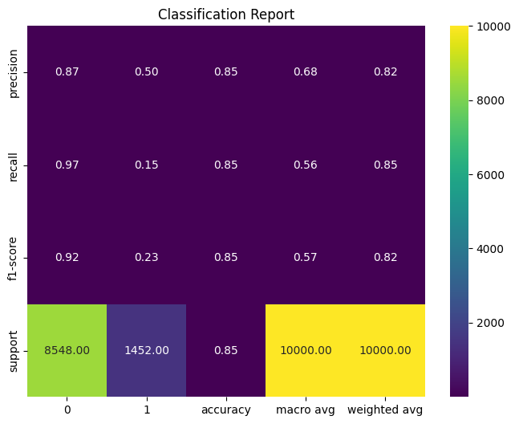
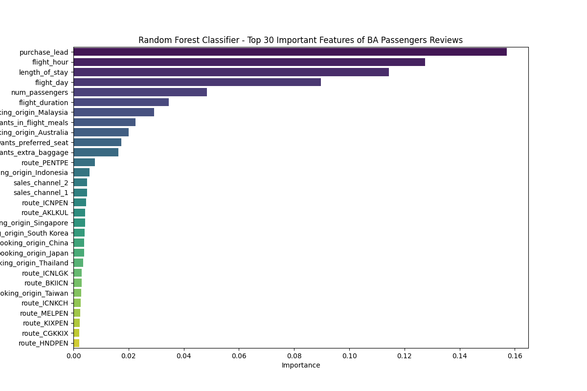
Predictive modeling of customer bookings
1. I used a RandomForestClassifier with (random_state=42)
as my model
2. Model is 85% accurate using 20% of our bookings dataset for testing
3. As shown in the classification plot below, purchase_lead is the most important feature in the training feature for our model

